Slide 1



Restaurant Food Delivery
Management System
Presented by Group 3
Name | NUID
Abhinav Manoj Menon | 001525815
Fengyi Zhang | 001564247
Jayesh Kumar Khattar | 001568947
Meghana Sivakumar | 001500850
Riddhi Bhatti | 001502713

Slide 2



OBJECTIVE AND PROBLEMS ADDRESSED
lack of an organized system to browse the desired cuisines based on ratings and menu and get it delivered home
Welcome to Restaurant Food delivery Management System – a centralized system which helps in ordering food online and helps user in making a food choices based on previous order history
Security and Automation – Credentials of the database users have been encrypted and created automated flows to ease the task of database admin
Delivery Tracking – Our system helps in tracking the delivery times of each order and based on this information we can figure out the performance of the delivery partner
Feedback Mechanism – Customer can share the feedback after receiving the order which helps various restaurants to improve their performance and it will also help customers with information of good restaurants.
Data Visualization - Graphs, charts can be used to analyze trends , feedback which helps businesses make critical decision to improve their service.

Slide 3
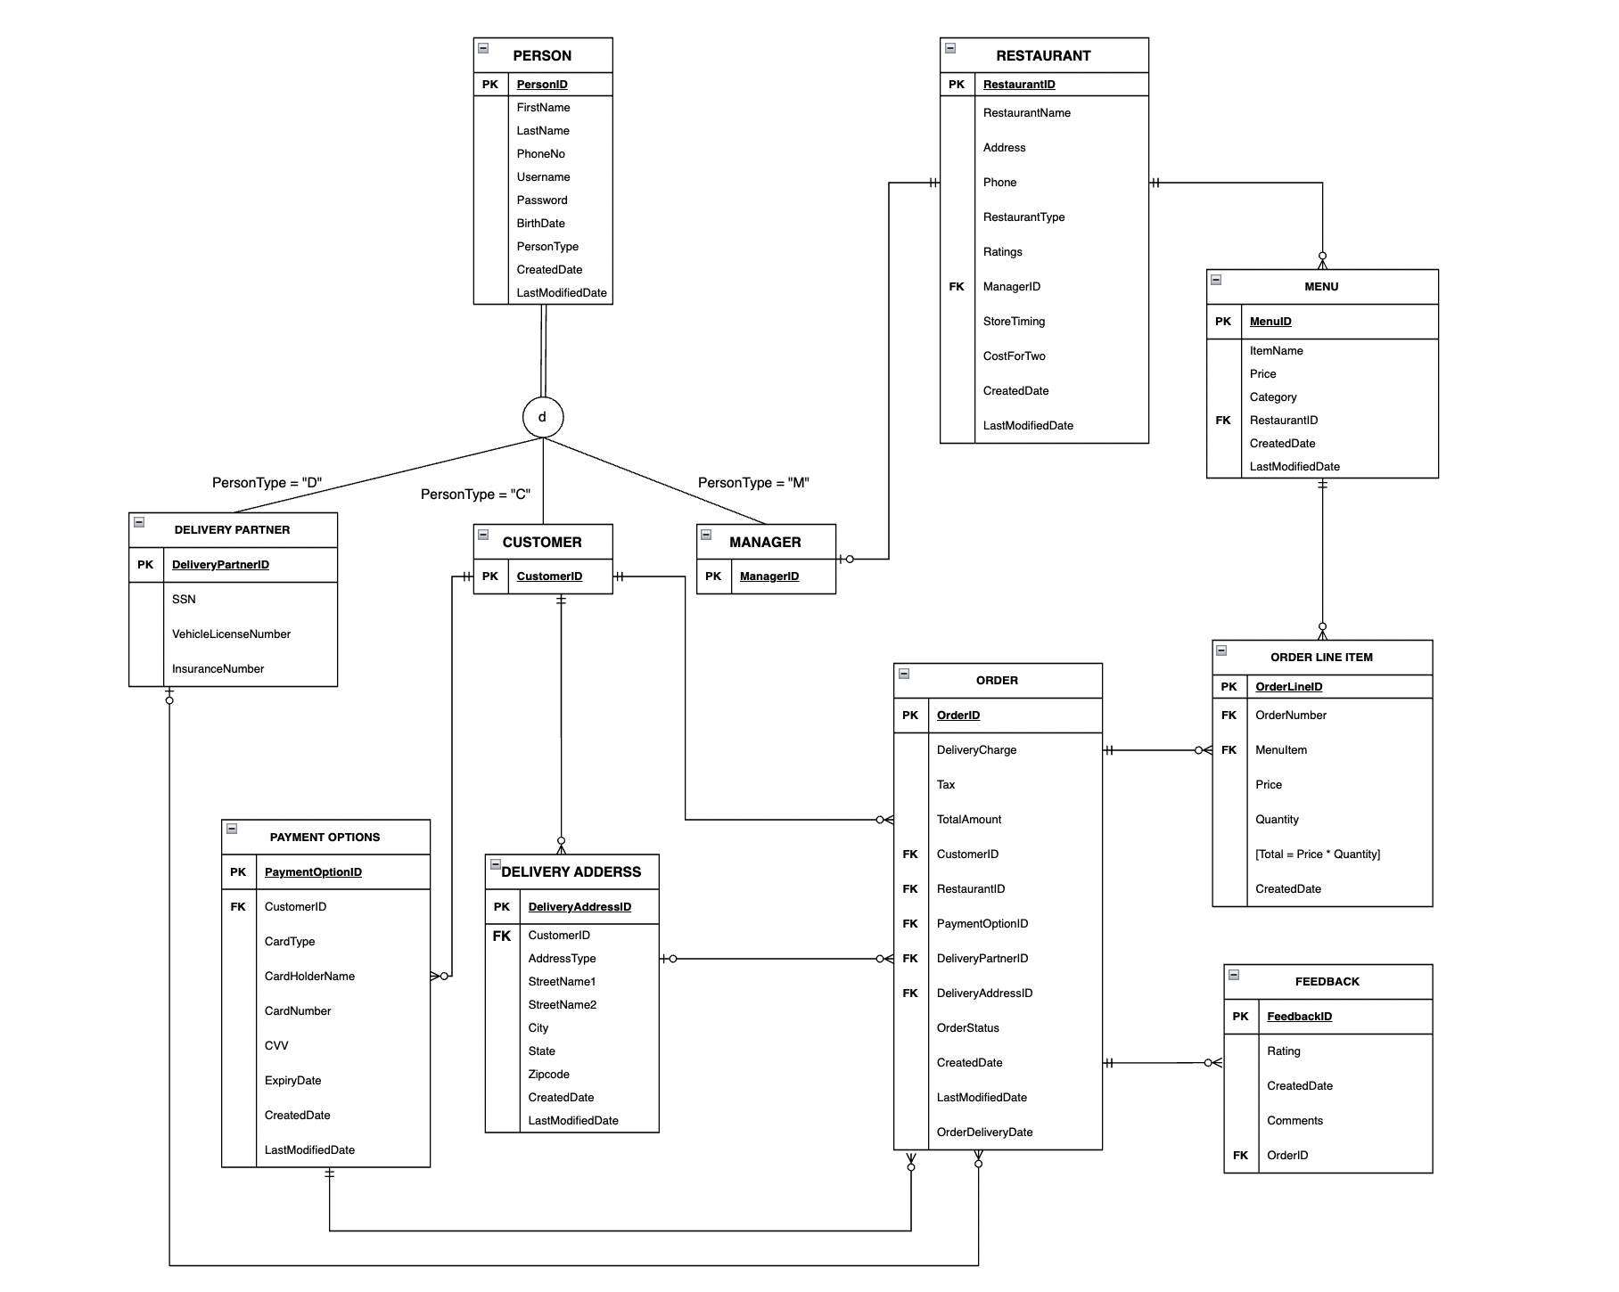
E-R DIAGRAM
Entity Relationship Diagram is the absolute key to a proficient, organized database design.
It’s essential for modeling the data stored in a database.

Slide 4
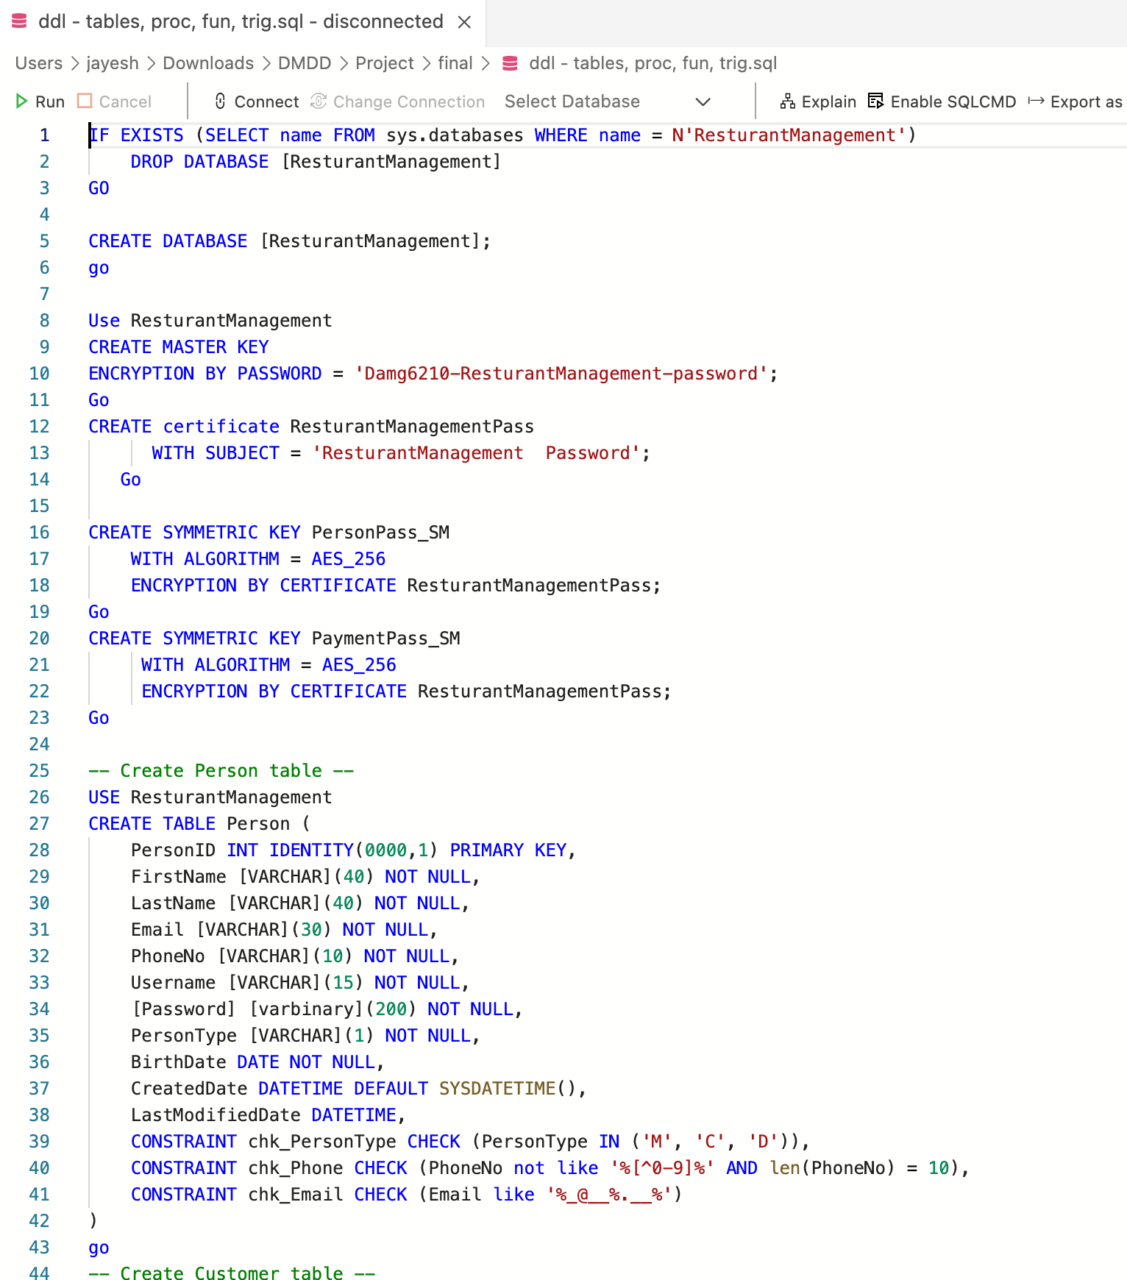
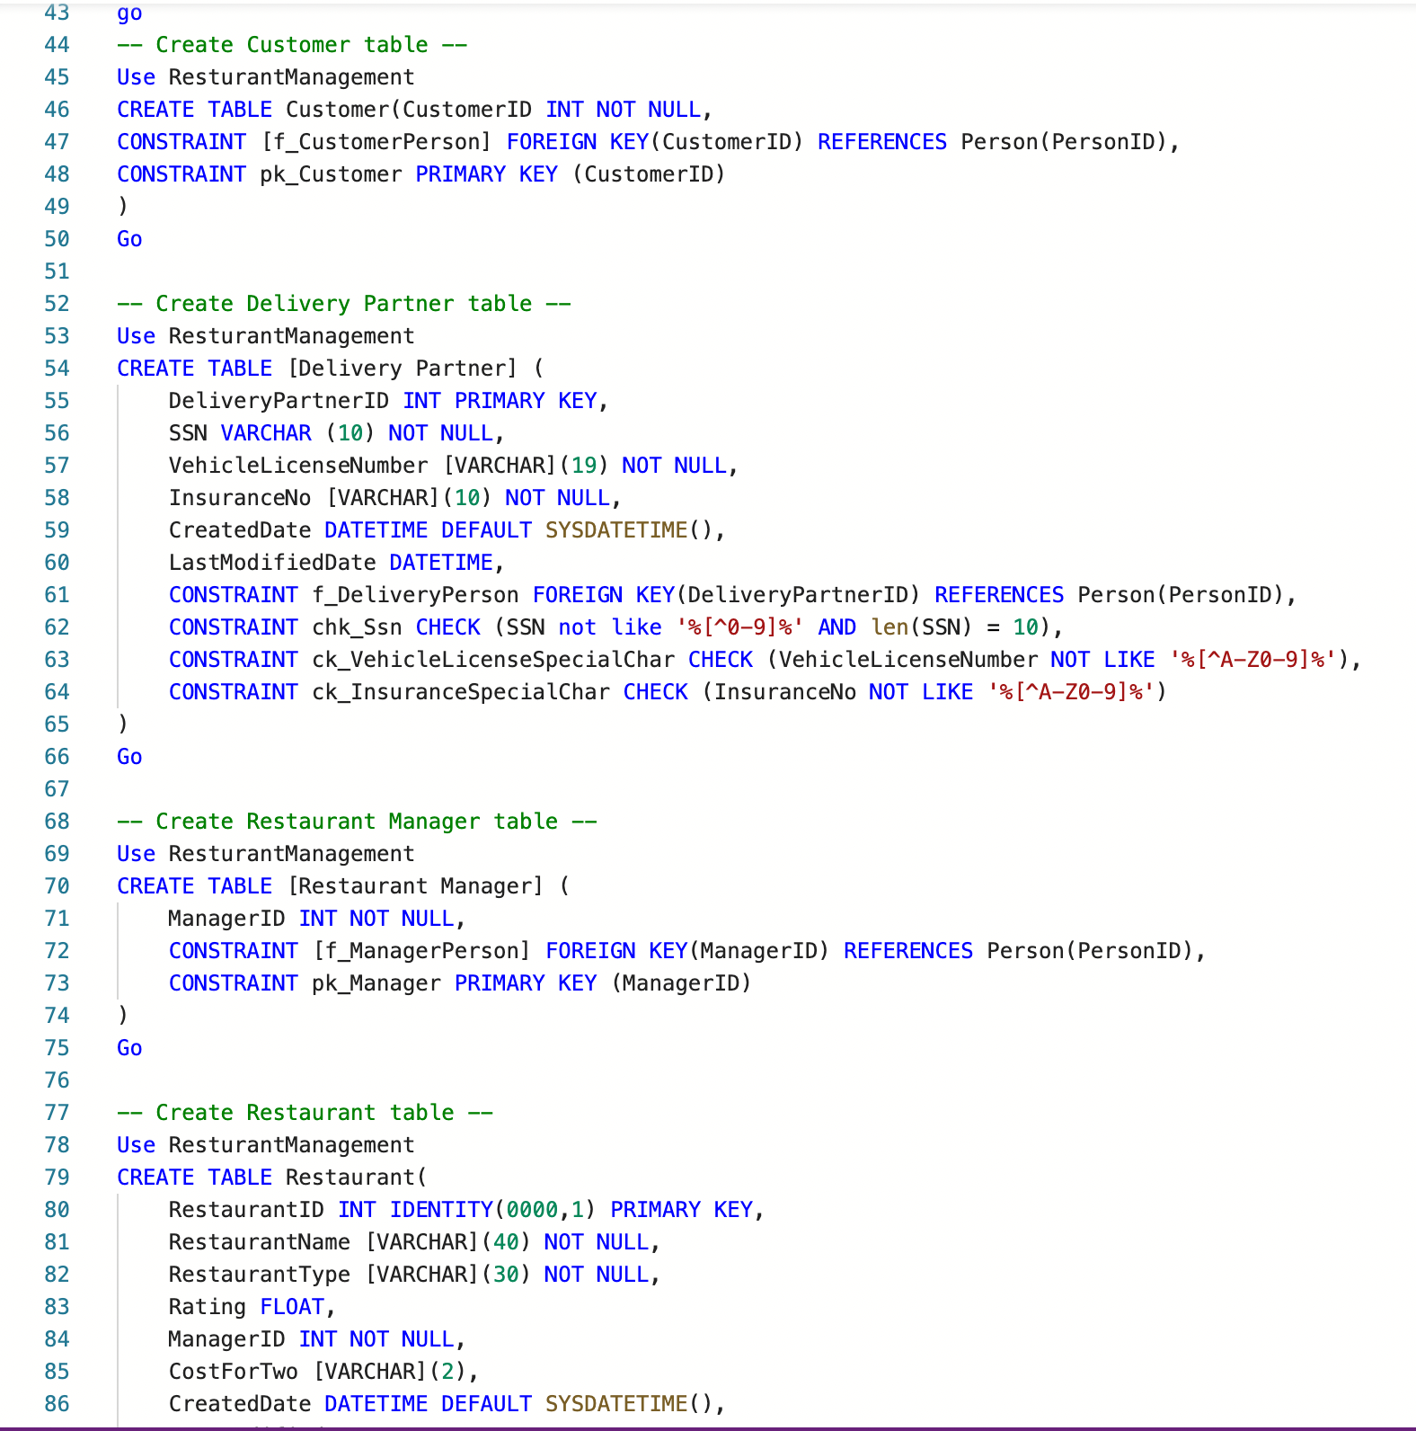
DDL STATEMENTS
Tables | 11
Our database system, is made up of the following table and their definitions -
Table Name | PK | FK | Constraints
Person | Yes | No | 3
Customer | Yes | Yes | 0
[Restaurant Manager] | Yes | Yes | 0
[Delivery Partner] | Yes | Yes | 4
Restaurant | Yes | Yes | 2
[Payment Options] | Yes | Yes | 1
[Delivery Address] | Yes | Yes | 3
Menu | Yes | Yes | 0
[Order] | Yes | Yes(5) | 2
[Order Line] | Yes | Yes(2) | 0
Feedback | Yes | Yes | 0

Slide 5
STORED PROCEDURES
Procedures | 6
GetPassword - This SP helps us to retrieve the decrypted password
Use Case – To be used for verifying user while logging them with username and password
Input – password Eg. - EXEC GetPassword @customerID=2
UpdateOrderStatus - This Stored Procedure helps us to update order status of a particular order
Use Case – To be used for updating updating order status for an orderID
Input – OrderId, OrderStatus Eg. - EXEC UpdateOrderStatus @OrderID=2,@OrderStatus='Delivered';
GetRestaurant - This SP will help us to filter restaurants based on params.
Use Case – to be used to filter restaurants based on filter type and filter value.
Input – FilterType, FilterValue Eg. 1 - EXEC GetRestaurant @columnname='City',@columnnvalue="'Boston’”,
Eg. 2 EXEC dbo.GetRestaurant @columnname='RestaurantType',@columnnvalue="'Indian'"
UpdateOrderAmount- This SP helps us to update order amount from all the order line items.
Use Case – Use to calculate total order amount with the help of User Defined Function.
Input – Order Id Eg. - EXEC UpdateOrderAmount @OrderID=2, @OrderTotal = @OrderTotal output;
GetOrderHistory - This SP helps us to retrieve the order history of a particular customer.
Use Case – To be used for fetching order history of a customer.
Input – CustomerId Eg. - EXEC GetOrderHistory 0
GetPaymentOptions - This SP helps us to payment options of a customer.
Use Case – to be used when fetching payment options of a customer.
Input – CustomerID Eg. - EXEC dbo. GetPaymentOptions @CustomerID=10

Slide 6
USER DEFINED FUNCTION
Computed Column on UDF | 1
User Defined Function | 1
GetOrderAmount –
This UD function is called from a procedure-> UpdateOrderAmount
Using this, we calculate the total order amount on Order using summation of price and quantity columns from Order Line and the amount based on OrderID
VIEWS
Views | 3
getRestaurantProfit - This view helps us to identify the profits earned by each restaurant
OrderFeedback - This view helps us to view feedbacks for orders by all customers
Order_placed - This view helps us to identify the no. of orders placed with each restaurant

Slide 7
TRIGGERS
Triggers | 6
After Insert on Person [Create Person according to Profile selected]
Automatically creates Customer And Manager based on person Type selected.
After Update Trigger on Order [Update order Delivery date on Order]
Automatically updates today’s order Delivery date on Order after order is delivered
After Update Trigger on Person, Restaurant, Order [Update Last modified date]
Automatically updates last modified date on the records in order to use it while auditing for any record in any of the above tables.

Slide 8
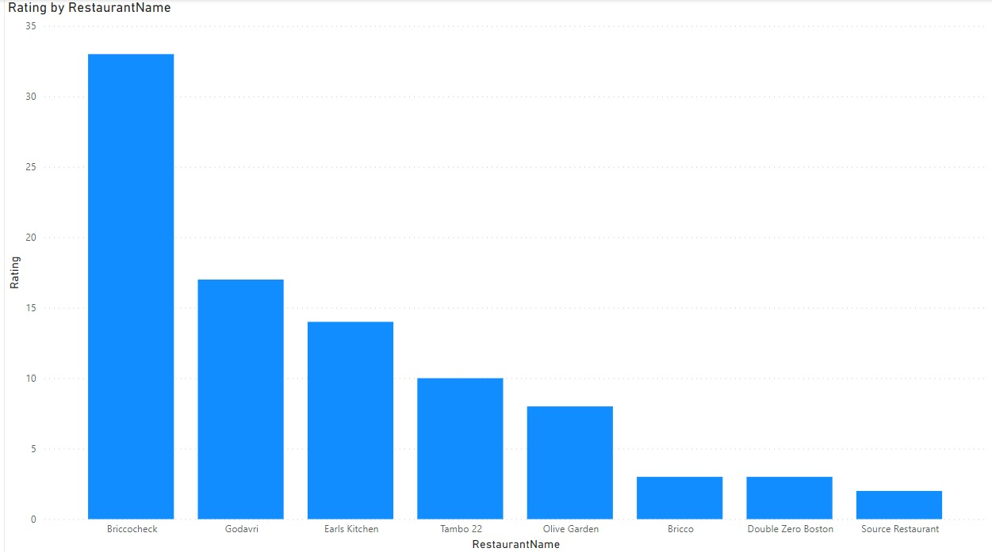
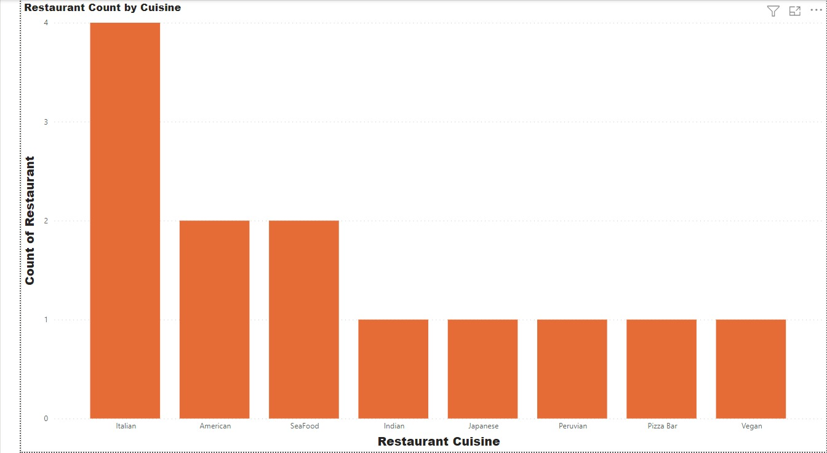
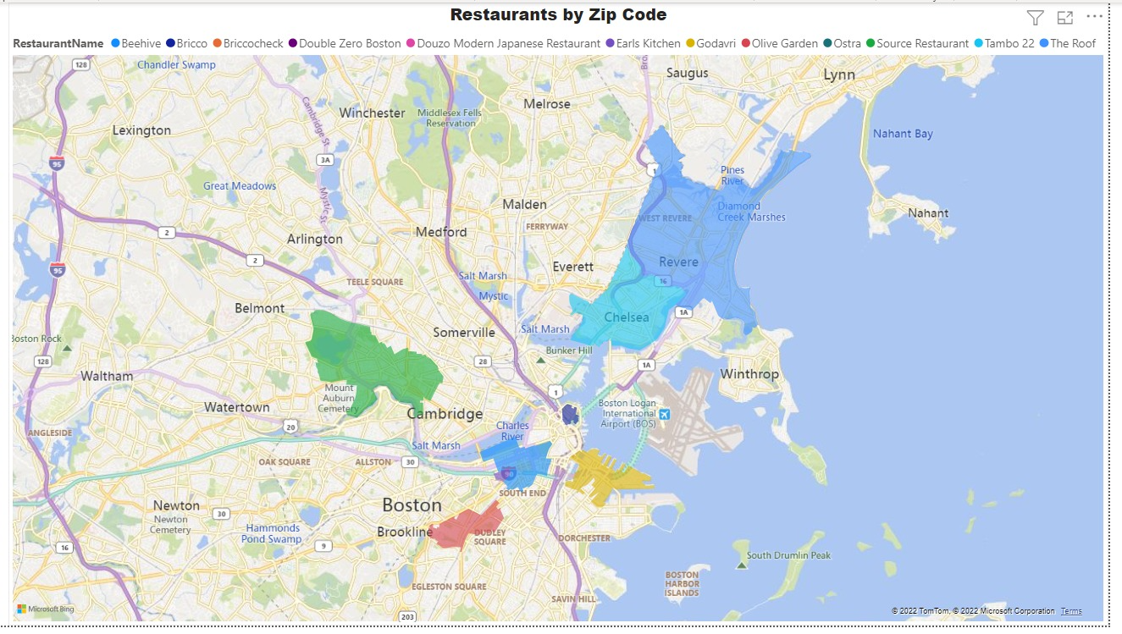
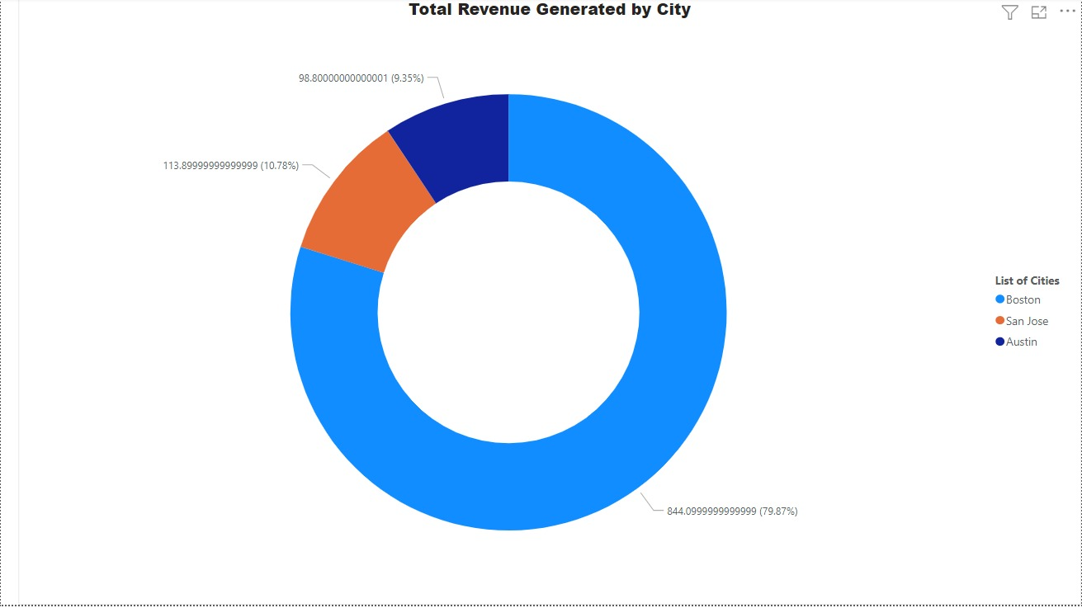
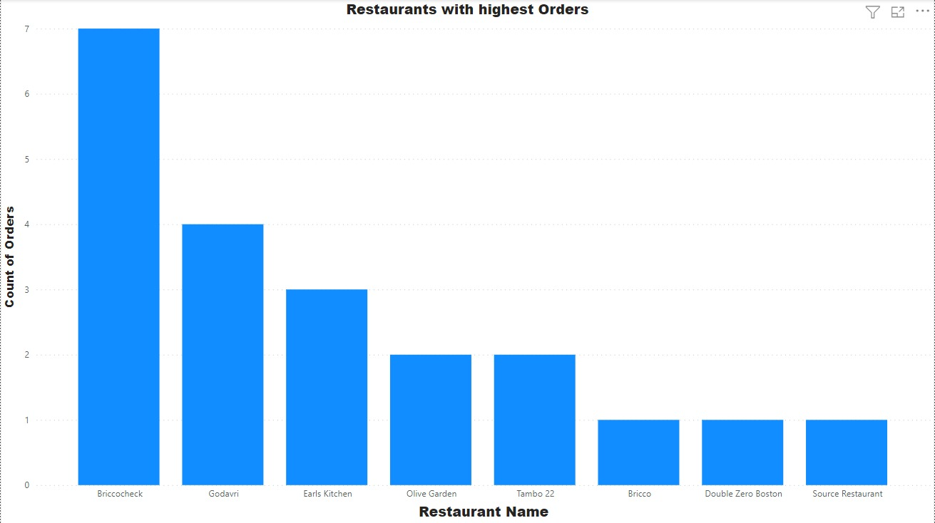
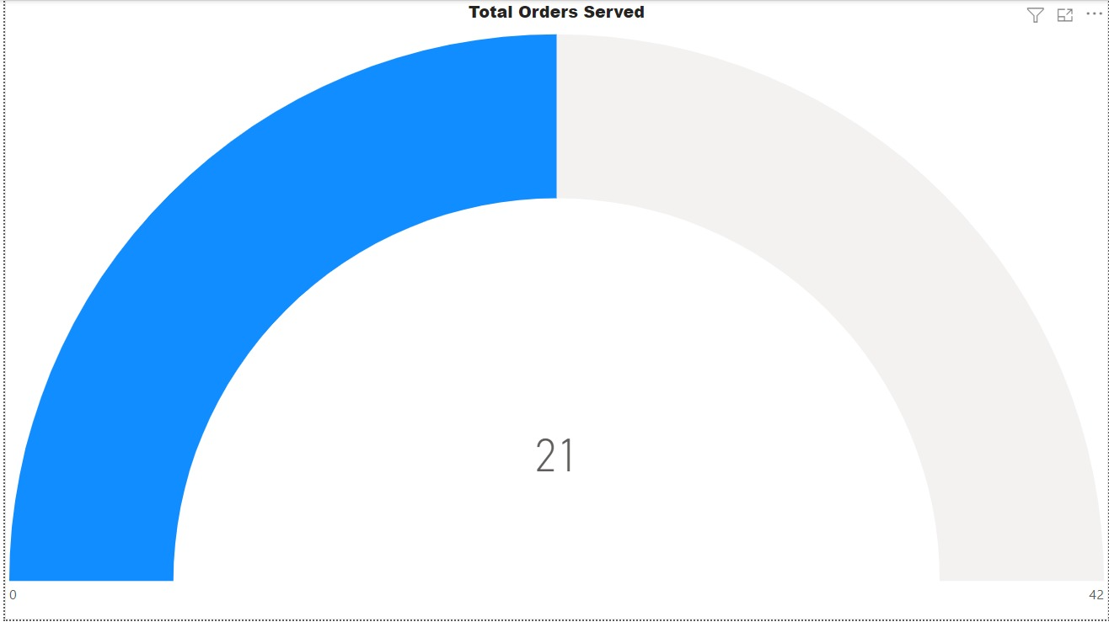
POWER BI VISUALIZATION

Slide 9
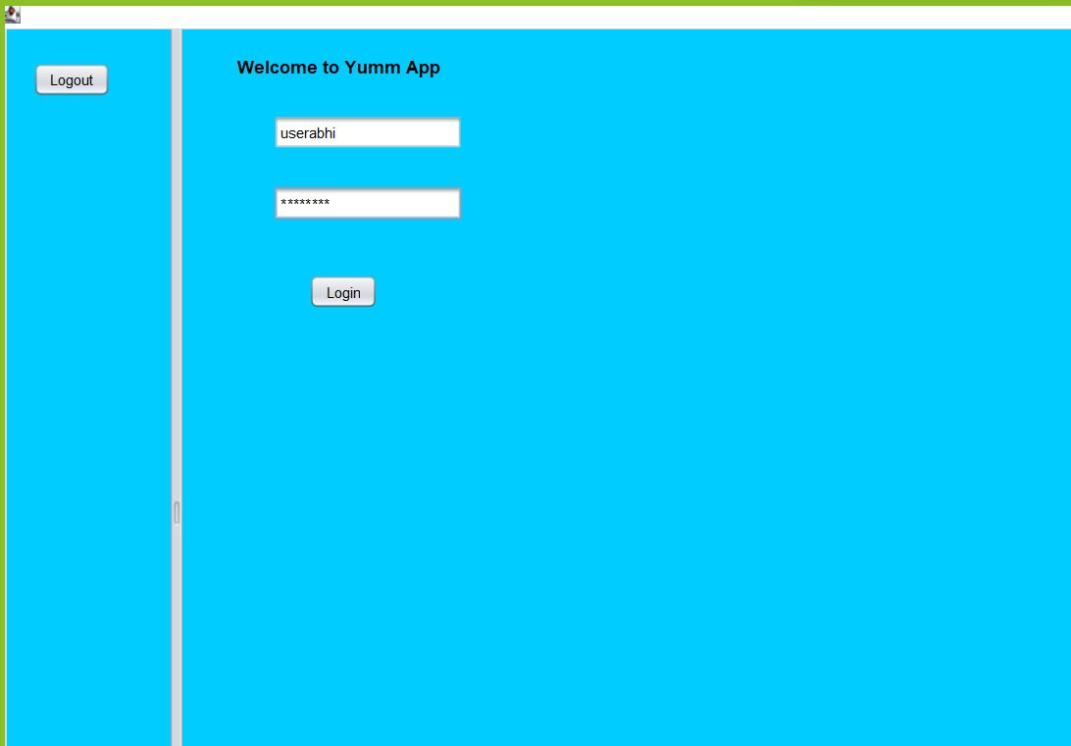
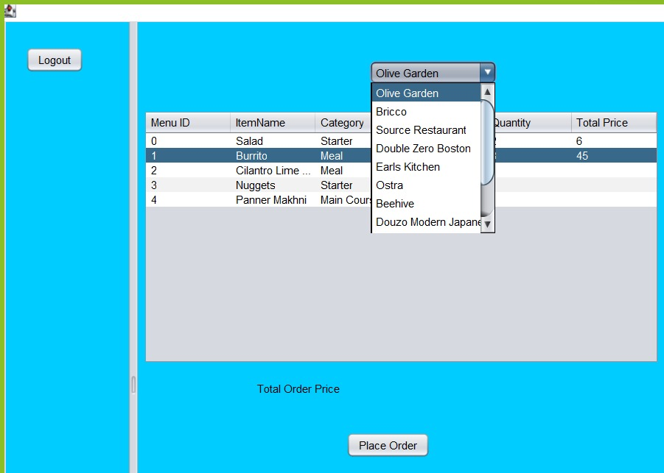
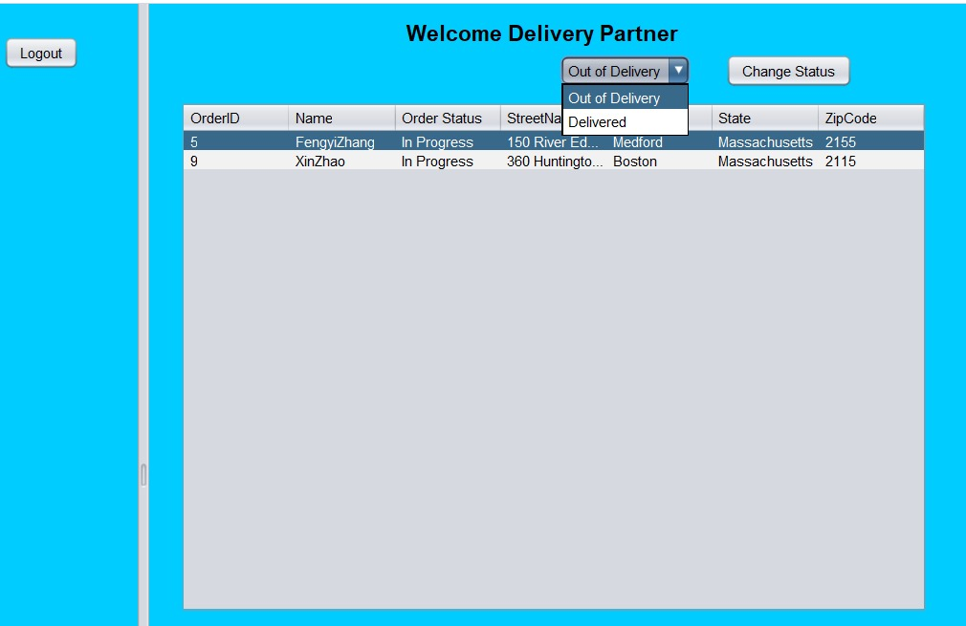
Login Screen -
GUI
Customer Login Screen -
Delivery Partner Screen -

